Slide 1
Chapter 30: Graph Analytics
Jared Hall, radeeb bashir

Slide 2
Graph Basics
Definition:
A graph is a data structure that is composed of a collection of vertices (nodes) and edges.

Slide 3
Graph Basics
Definition:
A graph is a data structure that is composed of a collection of vertices (nodes) and edges.
Notes:
Nodes are arbitrary objects (e.g. people in a friends list)

Slide 4
Graph Basics
Definition:
A graph is a data structure that is composed of a collection of vertices (nodes) and edges.
Notes:
Nodes are arbitrary objects (e.g. people in a friends list)
Edges consist of a set of tuples (pairs of nodes) that represent a relationship.

Slide 5
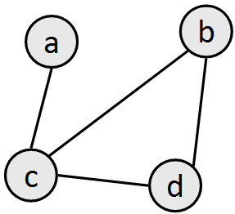
Graph Basics
Definition:
A graph is a data structure that is composed of a collection of vertices (nodes) and edges.
Notes:
Nodes are arbitrary objects (e.g. people in a friends list)
Edges consist of a set of tuples (pairs of nodes) that represent a relationship.
Example:
Nodes: {a, b, c, d}
Edges: {(a, c), (c, b), (c, d), (b, d)}

Slide 6
Graph Basics: Cont.
Notes:
Edges and vertices can have data associated with them.
E.g edges can have directions, weights, or names. Vertices can also have weights or names.

Slide 7
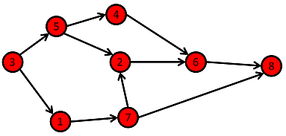
Graph Basics: Cont.
Notes:
Edges and vertices can have data associated with them.
E.g edges can have directions, weights, or names. Vertices can also have weights or names.
When the edge set contains ordered pairs of nodes the graph is a di-graph.

Slide 8
Graph Basics: Cont.
Notes:
Edges and vertices can have data associated with them.
E.g edges can have directions, weights, or names. Vertices can also have weights or names.
When the edge set contains ordered pairs of nodes the graph is a di-graph.
There are many different types of graphs depending on associated data.
Weighted directed graphs
Flow networks ~ source and sink.
Directed acyclic graphs

Slide 9
Use cases for graph analytics
Graphs are an excellent way to describe the relationships between a wide variety of things.

Slide 10
Use cases for graph analytics
Graphs are an excellent way to describe the relationships between a wide variety of things.
Some useful applications of graph analytics in the real world include:
Card fraud

Slide 11
Use cases for graph analytics
Graphs are an excellent way to describe the relationships between a wide variety of things.
Some useful applications of graph analytics in the real world include:
Card fraud
Motif finding

Slide 12
Use cases for graph analytics
Graphs are an excellent way to describe the relationships between a wide variety of things.
Some useful applications of graph analytics in the real world include:
Card fraud
Motif finding
Importance of references in scientific literature

Slide 13
Use cases for graph analytics
Graphs are an excellent way to describe the relationships between a wide variety of things.
Some useful applications of graph analytics in the real world include:
Card fraud
Motif finding
Importance of references in scientific literature
Ranking web pages
And many more. (basically any application where the relationships between objects provides some information).

Slide 14
Graphs for RDD: GraphX
Provides a very low-level interface for graph analytics that is both powerful and fast when applied to Spark.
Not easy to use or optimize, especially with sparks DataFrame and DataSet objects.

Slide 15
Graphs for Spark: GraphFrames
An extension of the GraphX library made by the creators of Spark for Sparks central data structures.
The key differences between GraphX and GraphFrames:
Dataframes vs. RDD’s
The GraphFrames API has the same API as Dataframes which allows SQL, Aggregations, etc.

Slide 16
Building a Graph with GraphFrames
Main steps for building a Graph:
Starting with two tables (preferred) or with one table preprocessed into two tables :one for the vertices, one for the edges.

Slide 17
Building a Graph with GraphFrames
Main steps for building a Graph:
Starting with two tables (preferred) or with one table preprocessed into two tables :one for the vertices, one for the edges.
Define the vertices (nodes) as a DataFrame.

Slide 18
Building a Graph with GraphFrames
Main steps for building a Graph:
Starting with two tables (preferred) or with one table preprocessed into two tables :one for the vertices, one for the edges.
Define the vertices (nodes) as a DataFrame.
Define the edges as a DataFrame.

Slide 19
Building a Graph with GraphFrames
Main steps for building a Graph:
Starting with two tables (preferred) or with one table preprocessed into two tables :one for the vertices, one for the edges.
Define the vertices (nodes) as a DataFrame.
Define the edges as a DataFrame.
Add to graph using the GraphFrames class constructor.
That’s it!

Slide 20

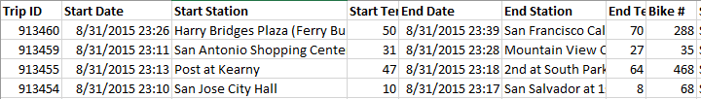
Building a Graph with GraphFrames
Dataset:
Bike data from the Bay Area Bike Share Portal
Table with station data
Table with trip data
Directed Graph : Trips starting location to trips ending location

Slide 21
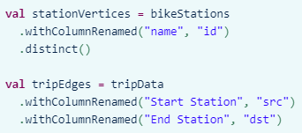
Building a Graph with GraphFrames
Vertex DataFrame: containing vertices (or nodes) – Bike Stations
Edge DataFrame: Bike Trips between the stations
GraphFrames : process is incredibly simple
Required naming conventions
Vertex DataFrame: special column named “id” which specifies unique IDs for each vertex in the graph.
Edge DataFrame: two special columns: “src” (source vertex ID of edge) and “dst” (destination vertex ID of edge).

Slide 22

Building a Graph with GraphFrames
Add to graph using the GraphFrames class constructor
Basic Statistics

Slide 23
GraphFrames: Analytics Methods
Most basic way of interacting with the graph : Querying
GraphFrames retains the DataFrame methods for querying data.
Aggregations: e.g. .count(), .min(), .max(), etc.
Very similar query structure: e.g.
E.g:
Counting trips
Filtering by given destinations
Note: Graph retains all additional columns in addition to IDs, sources and destination for example the ‘bike #’ for the trips
graph.vertices.groupBy().min("age").show()

Slide 24
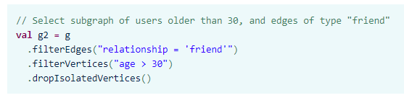
GraphFrames: Subgraphs
Smaller graphs within the larger one
Example: Subgraph containing all the vertices but edges that only represents trips in and out of a particular station
Simple query to get a subset of edges
Use this set of edges and vertices to create a subgraph using the GraphFrame class constructor
GraphFrame also provides APIs for building subgraphs by filtering on edges and vertices.
Example: the following subgraph contains only people who are friends and who are more than 30 years old.

Slide 25
GraphFrames: Graph Algorithms
Graph Algorithms allow us to performs numerous analytical tasks on our data.
Main Benefits of performing graph algorithms with GraphFrames:
Perform many popular algorithms out of the box
A currently updated and ever expanding library of algorithms for graphical analysis
Example: PageRank, Connected Components, Breadth-First Search

Slide 26
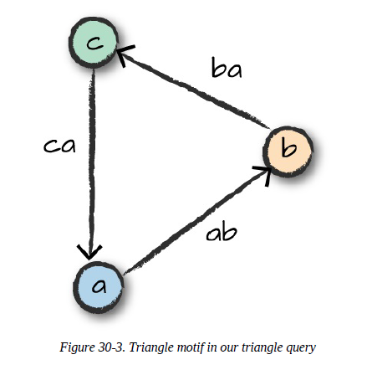
Graph Algorithms: Motif Finding
Discover structural patterns in our graphs
Querying for patterns in data instead of actual data
Query is done using domain specific language that lets us specify combinations of vertices and edges and assign them names
(a) – [ab] -> (b) : given vertex a connects to another vertex b through an edge ab
Names inside parenthesis/brackets signify vertices and edges names in the resulting DataFrame
Example: Finding all the rides that form a triangle pattern between 3 stations.
Powerful Feature of GraphFrame: Combining motif finding with DataFrame queries
Other uses:
Recommendation- Patterns in purchasing graphs to gain insights about customers by finding
relationships between different products.

Slide 27
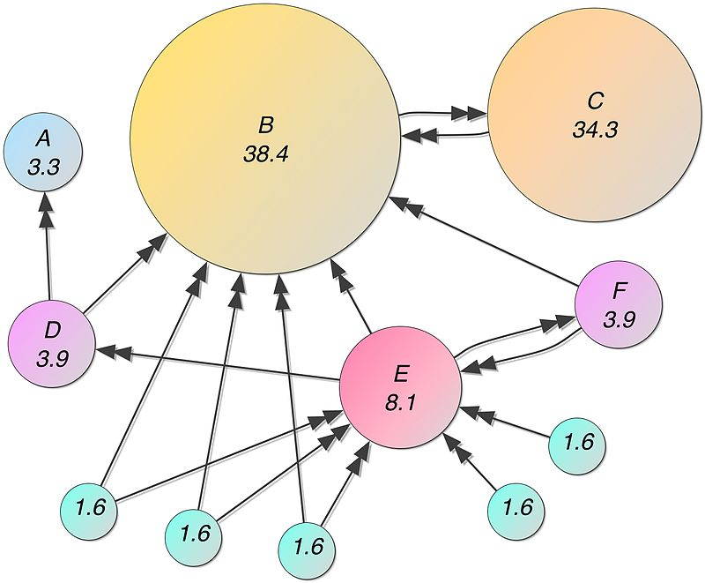
Graph Algorithms : PageRank
Popular graph algorithm created by Larry Page, cofounder of Google
Used as part of the google search engine
Main idea: counts the number and quality of links to a page to determine the importance of a website. More important websites are likely to receive more links from other websites

Slide 28

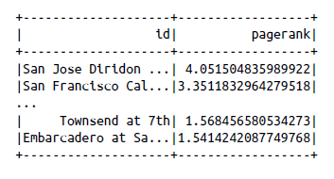
Graph Algorithms : PageRank
PageRank Generalizes well in domains other than the web
Example: Bike Data- More important bike stations will have more bike trips (edges) connected to them i.e will have a greater page rank

Slide 29
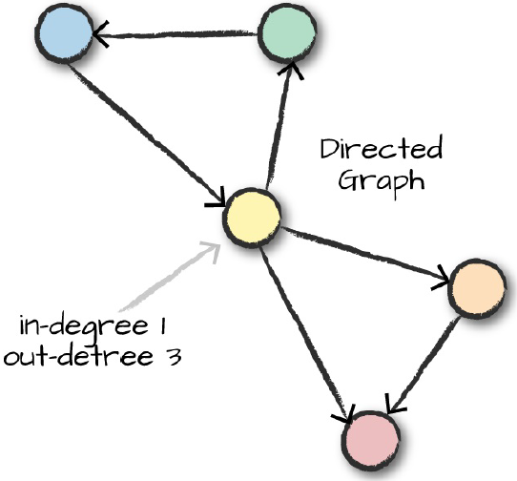
Graph Algorithms : In-Degree and Out-Degree Metrics
One of the more common tasks when performing analysis on a directed graph is to know the number of objects a node has a certain type of relation with.
E.g:
Count the number of trips an uber takes into or out of a given location such as an airport.
Count the number of followers and followed people for a particular social media account.
These types of questions call for the analysis of the In-Degree and Out-Degree metrics for a graph.

Slide 30
Graph Algorithms : In-Degree and Out-Degree Metrics
Collecting In-Degree and Out-Degree metrics in Spark:
val inDeg = stationGraph.inDegrees
inDeg.orderBy(desc("inDegree")).show(5, false)
val outDeg = stationGraph.outDegrees
outDeg.orderBy(desc("outDegree")).show(5, false)

Slide 31
Graph Algorithms : In-Degree and Out-Degree Metrics
The ratio of these two values is an interesting metric to look at:
val degreeRatio = inDeg.join(outDeg, Seq("id"))
.selectExpr("id", "double(inDegree)/double(outDegree) as degreeRatio")
degreeRatio.orderBy(desc("degreeRatio")).show(10, false)
degreeRatio.orderBy("degreeRatio").show(10, false)
This ratio can show us the difference between the two metrics.
Notes:
A higher ratio value will tell us
where a large number of trips end (but rarely begin), while a lower value tells us where trips often
begin (but infrequently end):

Slide 32
Graph Algorithms : Breadth-First Search
Breadth-first search (BFS) finds the shortest path(s) from one vertex (or a set of vertices) to another vertex (or a set of vertices). The beginning and end vertices are specified as Spark DataFrame expressions.
This can aid us in finding the shortest path between two nodes (with or without conditions).
Example:
stationGraph.bfs.fromExpr("id = 'Townsend at 7th'")
.toExpr("id = 'Spear at Folsom'").maxPathLength(2).run().show(10)

Slide 33
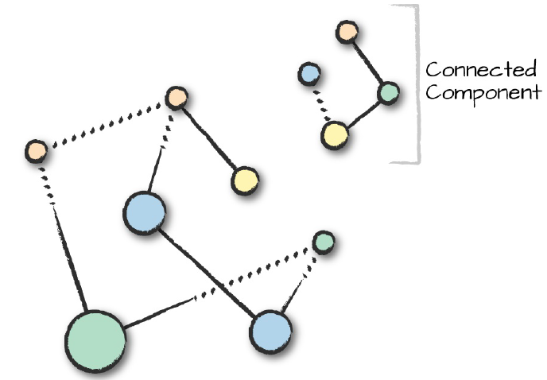
Graph Algorithms : Connected Components
A connected component defines an (undirected) subgraph that has connections to itself but does not connect to the greater graph.

Slide 34
Graph Algorithms : Connected Components
spark.sparkContext.setCheckpointDir("/tmp/checkpoints")
val minGraph = GraphFrame(stationVertices, tripEdges.sample(false, 0.1))
val cc = minGraph.connectedComponents.run()

Slide 35
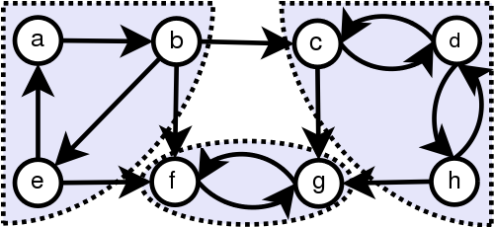
Graph Algorithms : Strongly Connected Components
A strongly connected component is a subgraph of a di-graph that has paths between all pairs of vertices inside it.
val scc = minGraph.stronglyConnectedComponents.maxIter(3).run()

Slide 36
References
http://www.twesdai.com/2017/09/15/motif-analysis-using-apache-spark-graphframes/
https://en.wikipedia.org/wiki/PageRank

Slide 37
Questions?

